Slide 1
SVPN
Long-term
unused user
policy change
2020.2

Slide 2
Ⅰ. SVPN long-term unused user policy change
￭ The SVPN long-term unused user policy has been changed as below.
￭ Long-term unused user policy - AS-IS : Expiration → Reapplication
- TO-BE : Dormancy → Self release of dormancy
※ How to release of dormancy ① SVPN portal sign in (auto-redirected to release page) ② Identity Authentication (Choose A or B) A) Enter external e-mail → OTP sent → enter OTP B) Enter Knox Portal ID/PWD
￭ Date of change - Feb. 13, 2020(Thu) 20:00 (Seoul, GMT+9) - Feb. 13, 2020(Thu) 06:00 (New York, GMT-5)
- Feb. 13, 2020(Thu) 11:00 (London, GMT+0)
※ In case of users who have expired before the application date, apply for reuse according to the existing process.

Slide 3
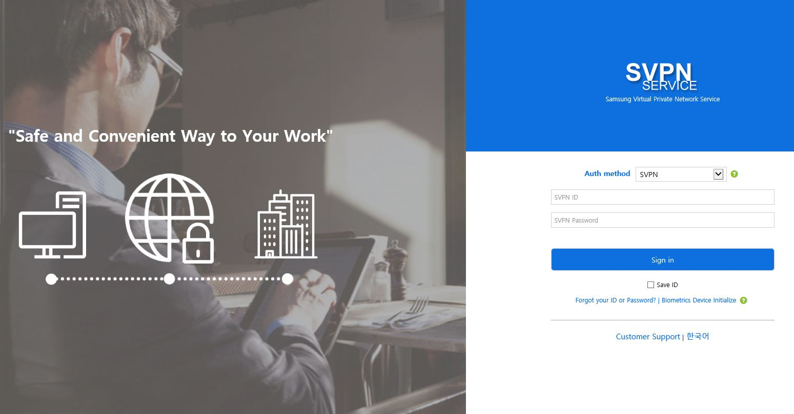
Ⅱ. SVPN long-term unused user account activation
1. Long-term unused user log-in

Slide 4
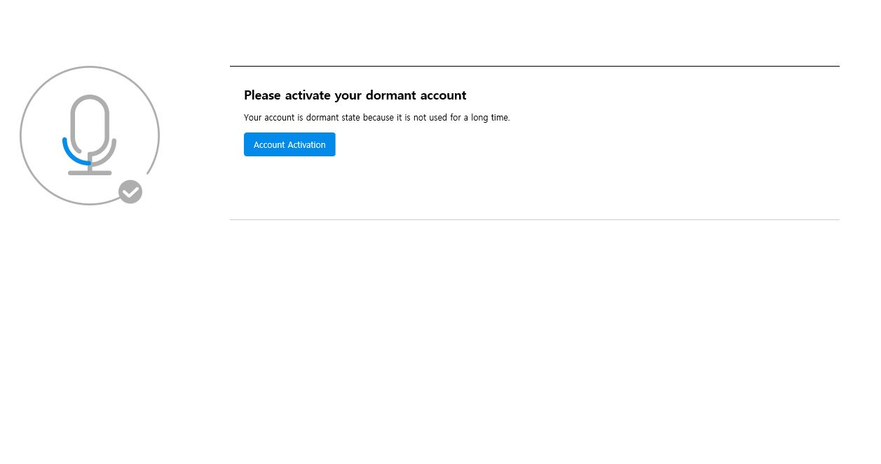
Ⅱ. SVPN long-term unused user account activation
2. User account activation message

Slide 5
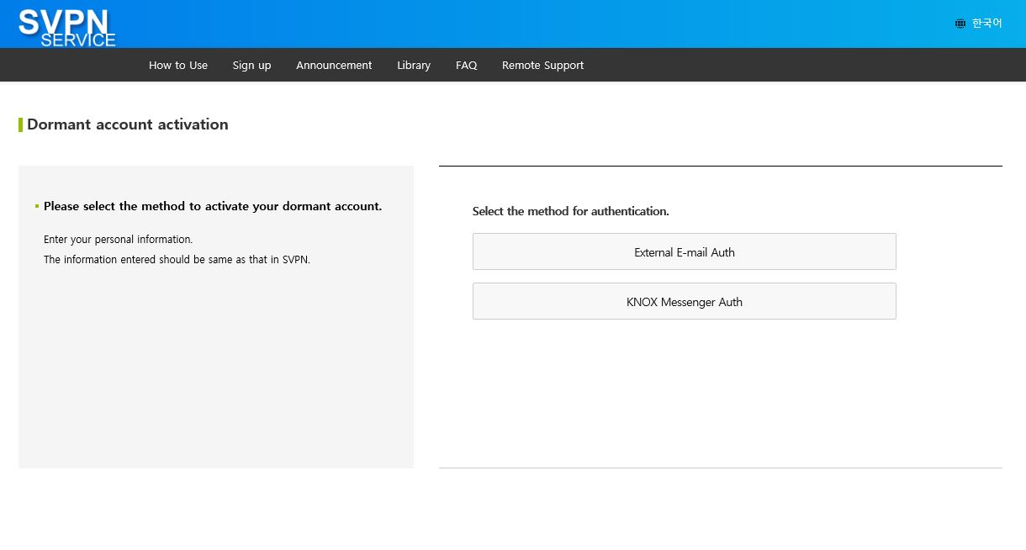
Ⅱ. SVPN long-term unused user account activation
3. Long-term unused user authentication
- Select one authentication method

Slide 6
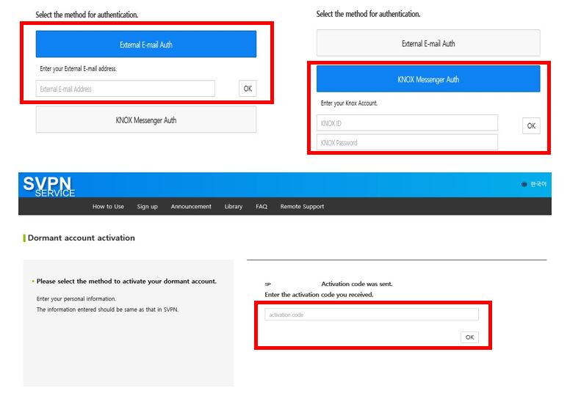
Ⅱ. SVPN long-term unused user account activation
3-1. Long-term unused user authentication
- Authenticate with the received authentication number

Slide 7
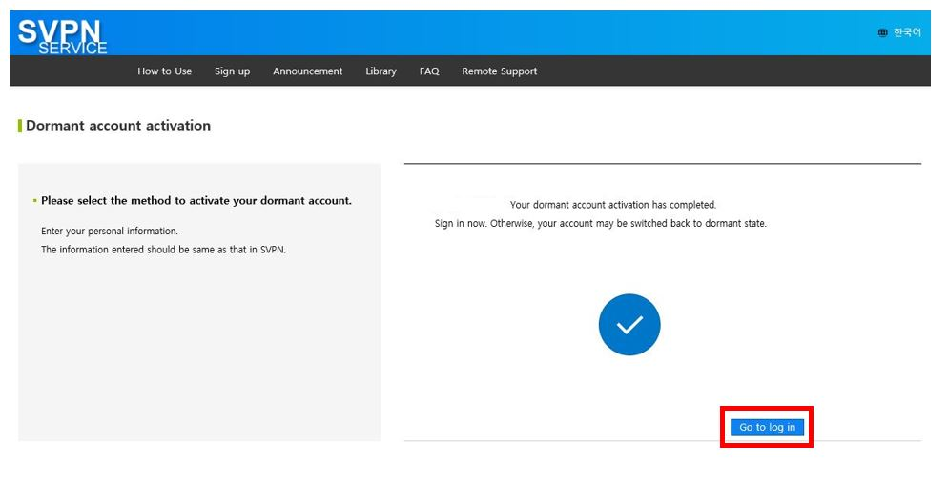
Ⅱ. SVPN long-term unused user account activation
4. User account activation and SVPN log in

